Slide 1
Text Mining I: Word Embedding and Spherical Text Embedding
Jiawei Han
Computer Science
University of Illinois at Urbana-Champaign
May 13, 2025

Slide 2
Outline
Text Mining, Text Similarity and Text Embedding
Unsupervised word embedding
Context-free representation
Euclidean Embedding: Word2Vec, GloVe, fastText
Local-Corpus Based Embedding
Hyperbolic Embedding: Poincaré and Lorentz Embedding
Spherical Text Embedding: JoSE (Joint Spherical Text Embedding)
Contextualized representation: ELMo, BERT, XLNet
CatE: Category-Name Guided Text Embedding for Topic Mining
Looking Forward

Slide 3
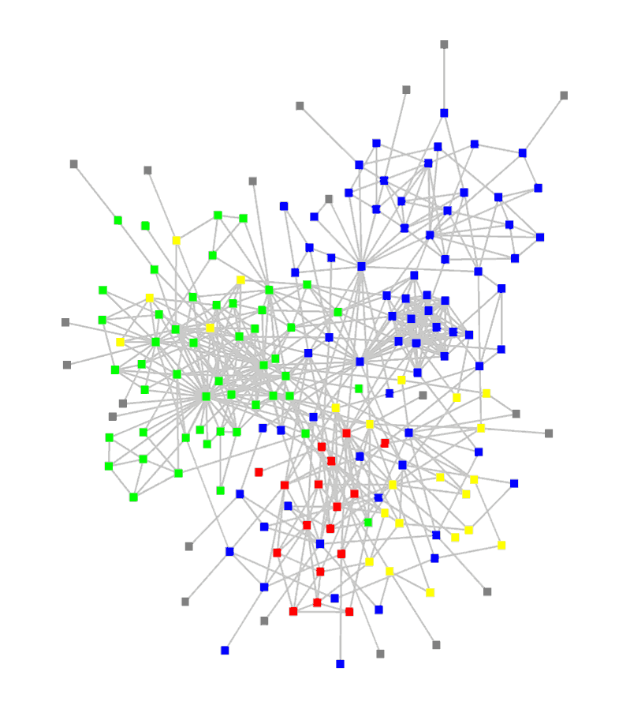
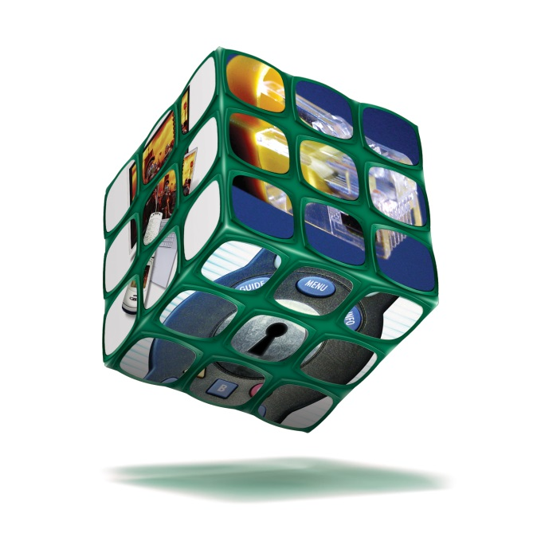
Over 80% of Our Big Data is Unstructured Text Data
Ubiquity of big unstructured, text data
Big Data: Over 80% of our data is from text/natural language/social media, unstructured/semi-structured, noisy, dynamic, …, but inter-related!
How to mine such big data systematically?
Structuring (i.e., transforming unstructured text into structured, typed, interconnected entities/relationships)
Embedding (i.e., computing similarities among entities and relations)
Networking (take advantage of massive, structured connections)
Our roadmap:
Mining hidden structures from text data
Turning text data into multidimensional text-cubes and typed networks
Mining cubes and networks to generate actionable knowledge

Slide 4

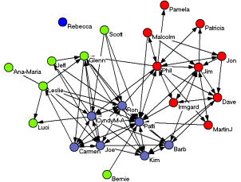








Bottleneck: Mining Unstructured Text for Structures
One of the most challenging issue at mining big data: structuring and mining text!!
Bottleneck: How to automatically generate structures from text data?
Automated mining of phrases, topics, entities, links and types from text corpora
Heterog. networks
Text Corpus
Phrases
Knowledge
General KB
Typed entities
Multi-dimensional Cubes

Slide 5
Text Representation: Vector Space Representation
Vector Space Representation
The sparse, multidimensional representation of text used in most applications
Term frequency (TF): tf_{i} = N(t_{i}, d) or take the log: f_{i} = log (tf_{i} + 1)
Inverted document frequency (IDF): idf_{i} = log (N/df_{i})
TF-IDF: tf_idf_{i} = tf_{i} X idf_{i}
Term i appears frequently in the current doc d but infrequent in other docs
Normalization (due to different doc length)
L-1 normalization:
L-2 normalization:
L-infinity normalization:

Slide 6
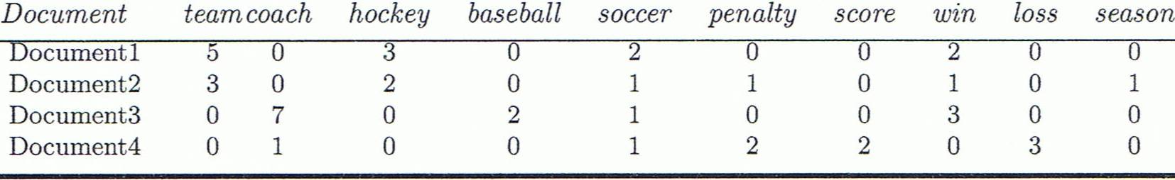
Similarity Computation in Text
A document can be represented by a bag of terms or a long vector, with each attribute recording the frequency of a particular term (such as word, keyword, or phrase) in the document
Cosine measure: If d₁ and d₂ are two vectors (e.g., term-frequency vectors), then
where • indicates vector dot product, ||d||: the length of vector d
Jaccard coefficient is used in some analysis:

Slide 7
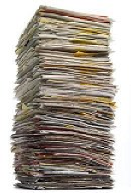
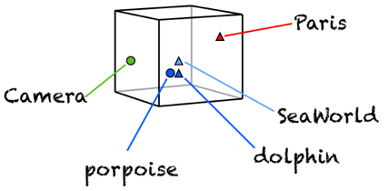
Big Data Challenge: The Curse of High-Dimensionality
Text: Word co-occurrence statistics matrix
High-dimensionality:
There are over 171k words in English language
Redundancy:
Many words share similar semantic meanings
Sea, ocean, marine..
Notes:
Heat map of word co-occurrence statistics matrix
For each word, the corresponding row as feature vector
Remove redundancy and project the data into a lower-dimensional space
Each dimension correspond to a topic

Slide 8
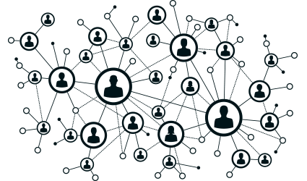
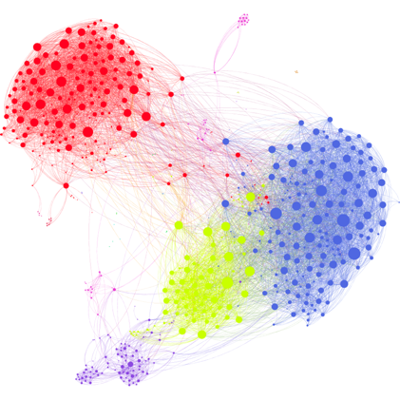
Multi-Genre Network Challenge: High-Dimensional Data too!
Adjacency Matrix
 | 1 | 2 | 3 | 4 | 5 | 6 | 7 | 8 | 9 | 10 | …
1 | 0 | 1 | 1 | 1 | 1 | 0 | 0 | 1 | 0 | 0 | …
2 | 1 | 0 | 1 | 1 | 0 | 0 | 1 | 0 | 0 | 0 | …
3 | 1 | 1 | 0 | 1 | 0 | 0 | 0 | 0 | 1 | 0 | …
4 | 1 | 1 | 1 | 0 | 0 | 0 | 0 | 0 | 0 | 0 | …
5 | 1 | 0 | 0 | 0 | 0 | 0 | 0 | 0 | 0 | 0 | …
6 | 1 | 0 | 0 | 0 | 0 | 0 | 0 | 0 | 0 | 0 | …
7 | 1 | 0 | 0 | 0 | 1 | 0 | 0 | 0 | 0 | 0 | …
8 | 1 | 1 | 1 | 1 | 0 | 0 | 0 | 0 | 0 | 0 | …
9 | 0 | 0 | 1 | 0 | 0 | 0 | 0 | 0 | 0 | 1 | …
10 | 0 | 0 | 1 | 0 | 0 | 0 | 0 | 1 | 0 | 1 | …
11 | 0 | 0 | 0 | 0 | 0 | 0 | 0 | 0 | 1 | 1 | …
12 | 0 | 1 | 0 | 0 | 0 | 0 | 0 | 0 | 1 | 1 | …
13 | 1 | 0 | 0 | 0 | 0 | 0 | 0 | 0 | 1 | 1 | …
14 | 0 | 0 | 1 | 0 | 0 | 1 | 1 | 1 | 0 | 1 | …
15 | 0 | 0 | 0 | 0 | 0 | 1 | 1 | 1 | 1 | 0 | …
… | … | … | … | … | … | … | … | … | … | … | …
High-dimension:
Facebook has 1860 Million monthly active users (Mar. 2017)
Redundancy:
Users in the same cluster are likely to be connected
Notes:
Unweighted network
For each object, the corresponding row as feature vector
Remove redundancy and project the data into a lower-dimensional space, represent the node based on the cluster it belongs to
Each dimension correspond to a cluster

Slide 9

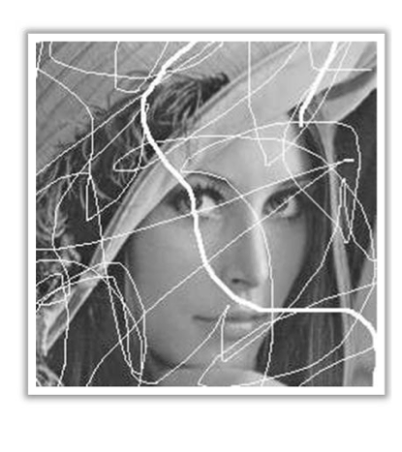
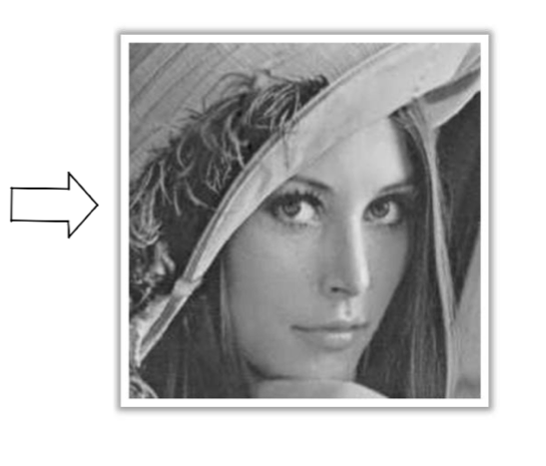
Solution to Data & Network Challenge: Dimension Reduction
Why Low-dimensional Space?
Visualization
Compression
Explanatory data analysis
Fill in (impute) missing entries (link/node prediction)
Classification and clustering
Identify / point
How to automatically identify the lower-dimensional space that the high-dimensional data (approximately) lie in

Slide 10
Dimension Reduction Approaches: Low-rank Estimation vs. Embedding Learning
: dimension in the low-dimensional space
Low-rank estimation
Data recovery
Imposing low-rank assumption
Regularization
Low-dimension vector space
Singular vectors (U)
= r
Low-rank Model
Embedding Learning
Representation Learning
Project data into a low-dimensional space
Low-dimensional vector space
Spanned by columns of U
≤ f
Generalized Low-rank Model
Notes:
Low-rank estimation for embedding learning (svd)
Embedding learning for low-rank estimation (matrix factorization)
Data recovery: noise, corruption, incomplete observations
Representation learning: transforming the feature space (reduce the number of features while preserving the proximity information)

Slide 11
Outline
Text Mining, Text Similarity and Text Embedding
Unsupervised word embedding
Context-free representation:
Euclidean Embedding: Word2Vec, GloVe, fastText
Local-Corpus Based Embedding
Hyperbolic Embedding: Poincaré and Lorentz Embedding
Spherical Text Embedding: JoSE (Joint Spherical Text Embedding)
Contextualized representation: ELMo, BERT, XLNet
CatE: Category-Name Guided Text Embedding for Topic Mining
Looking Forward

Slide 12
Word2Vec and Word Embedding
Word2vec: A two-layer neural net that processes text
Proposed by T. Mikolov et al. at Google (2013)
Input: A large text corpus
Output: A set of vectors, feature vectors for words in that corpus, of 10² dimensions
Words sharing common contexts are embedded in close proximity in the vector space
Embedding vectors created by Word2vec: better than LSA (Latent Semantic Analysis)
E.g., Sweden → Norway, Denmark, Finland, Switzerland, Belgium, Netherlands, …
Given enough data, usage and contexts, Word2vec can make highly accurate guesses about a word’s meaning based on past appearances

Slide 13
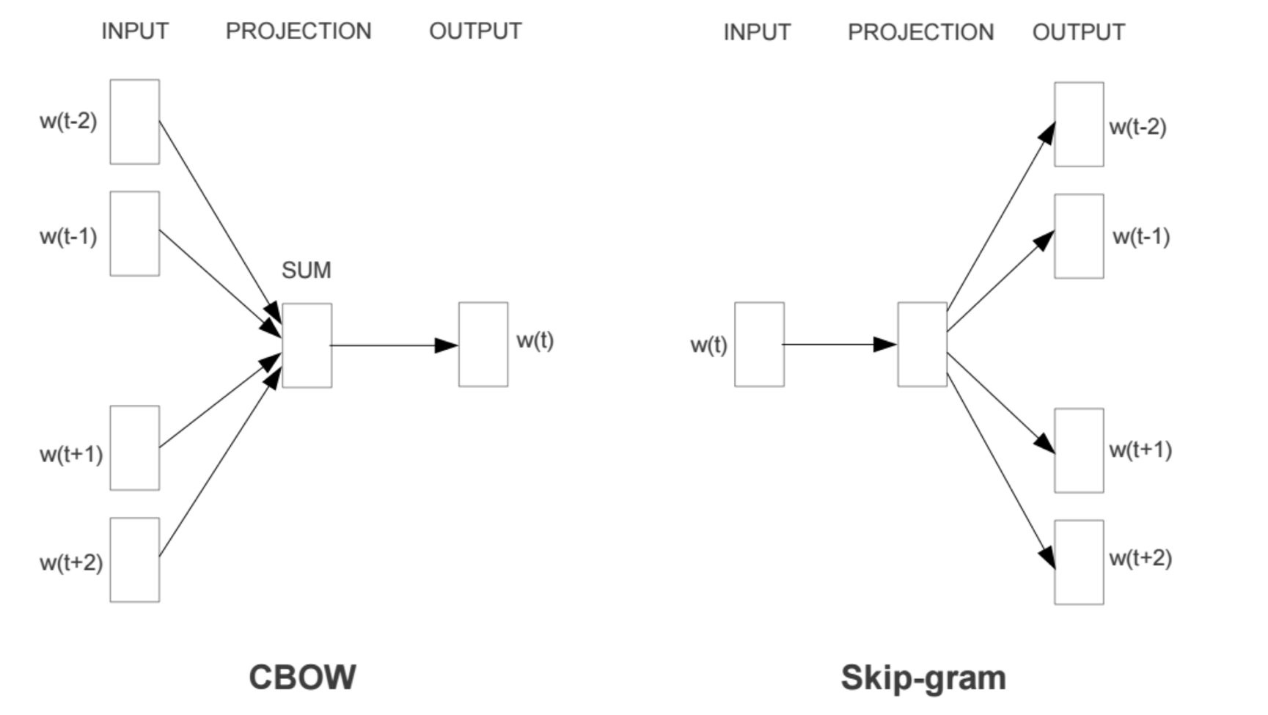
Word2Vec: CBOW vs. Skip-Gram Models
Two model architectures: Given a set of sentences (also called corpus),
Continuous bag-of-words (CBOW): Uses the contexts to predict the current word
faster than skip-gram, slightly better accuracy for the frequent words
Skip-gram: Uses the current word to predict its neighbors (its context)
Weigh nearby context words more heavily than more distant context words
Works well with small amount of the training data, represents well even rare words or phrases

Slide 14
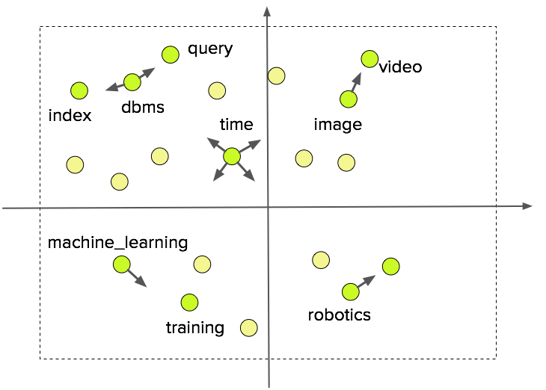
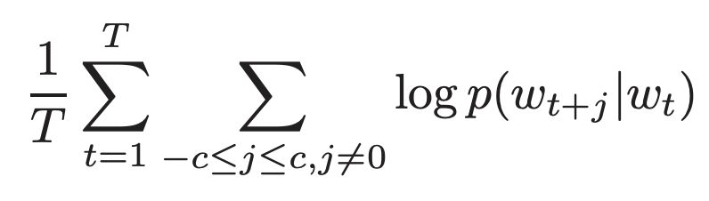
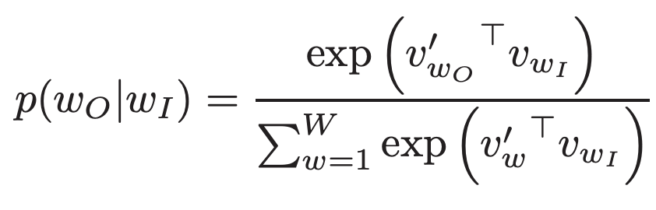
Unsupervised Word Embedding: Word2Vec
Unsupervised word embedding learning pushes together terms that share same or similar contexts
Specifically, Word2Vec maximizes the probability of observing a word based on its contexts
As a result, semantically coherent terms are more likely to have close embeddings
Co-occurred words in a local context window
Mikolov, T., Sutskever, I., Chen, K., Corrado, G.S., & Dean, J. (2013). Distributed Representations of Words and Phrases and their Compositionality. NIPS.

Slide 15
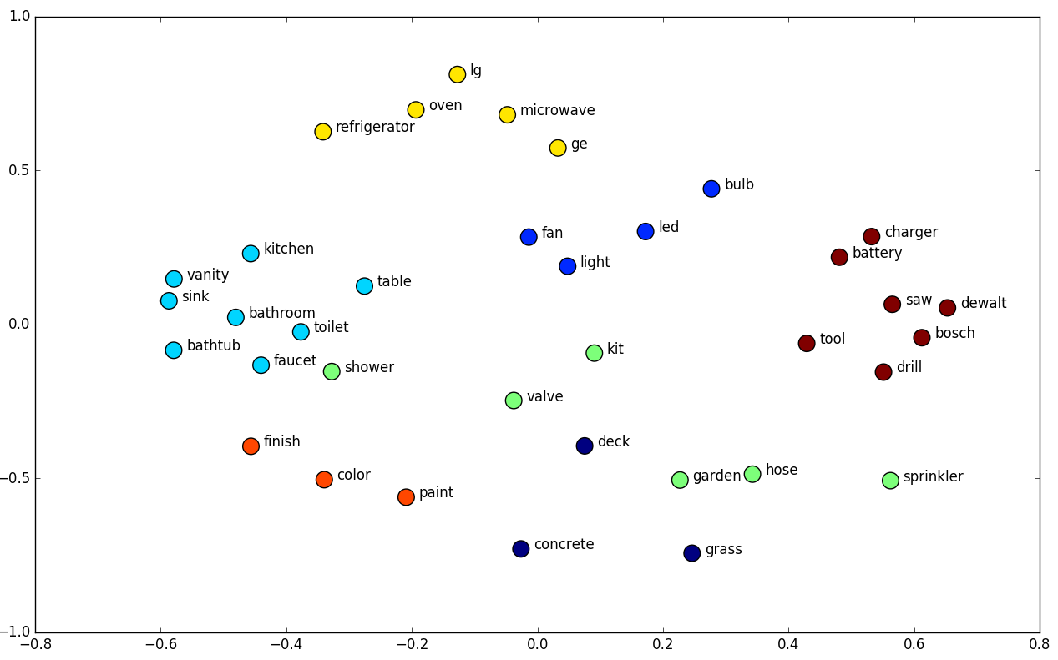

Text Embedding: A Milestone in NLP and ML
A milestone in NLP and ML: Unsupervised learning of text representations
Embed one-hot vectors into lower-dimens. space—Address “curse of dimensionality”
Word embedding captures useful properties of word semantics
Word similarity: Words with similar meanings are embedded closer
Word analogy: Linear relationships between words (e.g., king − queen = man−woman)
Word Similarity
Word Analogy
Typical embedding methods:
Word2Vec
GloVe
fastText
Trained in Euclidean space

Slide 16
Research on Embedding Is Exploding Since Word2vec
Word2vec is not a deep neural network, but it turns text into a numerical form that deep nets can understand
Neural word embedding represents a word with a vector of numbers
Word2vec is similar to an autoencoder, encoding each word in a vector
It trains words against other words that neighbor them in the input corpus
Applications: Analysis of text, genes, code, likes, other verbal/symbolic series
Many powerful embedding methods generated since then
GloVe (Global Vectors for Word Representation) J. Pennington, R. Socher, C. D. Manning (Stanford U.) EMNLP 2014
fastText: represents each word as an n-gram of characters, allows the embeddings to understand suffixes and prefixes
Network embedding: Embedding nodes in information networks
LINE, DeepWalk, Metapath2Vec, ……

Slide 17
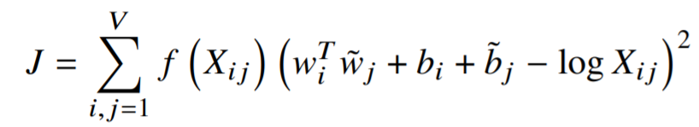
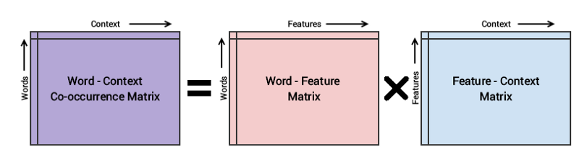
Unsupervised Word Embedding: GloVe
GloVe factorizes a global co-occurrence matrix derived from the entire corpus
Low-dimensional representations are obtained by solving a least-squares problem to “recover” the co-occurrence matrix
Sparse, high dimensional
Low dimensional representation
Pennington, J., Socher, R., & Manning, C.D. (2014). Glove: Global Vectors for Word Representation. EMNLP.

Slide 18
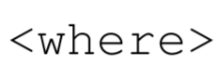
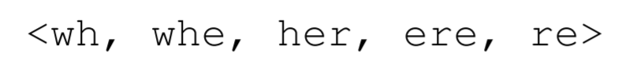
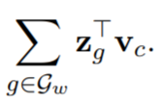
Unsupervised Word Embedding: fastText
fastText improves upon Word2Vec by incorporating subword information into word embedding
fastText allows sharing subword representations across words, since words are represented by the aggregation of their n-grams
Tri-gram extraction
Word2Vec probability expression
Represent a word by the sum of the
vector representations of its n-grams
N-gram embedding
Bojanowski, P., Grave, E., Joulin, A., & Mikolov, T. (2016). Enriching Word Vectors with Subword Information. Transactions of the Association for Computational Linguistics, 5, 135-146.

Slide 19
Outline
Text Mining, Text Similarity and Text Embedding
Unsupervised word embedding
Context-free representation:
Euclidean Embedding: Word2Vec, GloVe, fastText
Local-Corpus Based Embedding
Hyperbolic Embedding: Poincaré and Lorentz Embedding
Spherical Text Embedding: JoSE (Joint Spherical Text Embedding)
Contextualized representation: ELMo, BERT, XLNet
CatE: Category-Name Guided Text Embedding for Topic Mining
Looking Forward

Slide 20
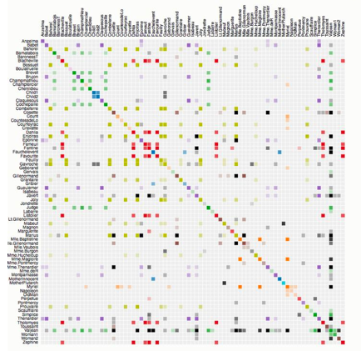

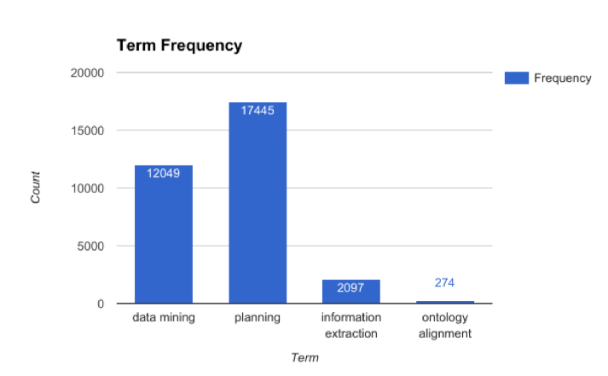
Problem: Expert Finding in Bibliographic Networks
Given a set of keywords, find related experts
Ex. Find expert on “information extraction”
Challenges: Vocabulary gap
“relation extraction”, “named entity recognition”, …
The power of word embedding
Use word embedding to close the vocabulary gap
Difficulty: Discrepancy in queries
Specific queries: Narrow semantic meanings
“Information Extraction”
“Ontology Alignment”
General queries: Broad semantic meanings
“Data Mining”
“Planning”

Slide 21
Local Embedding Training with Concept Hierarchy
Use a concept hierarchy as guidance
For an arbitrary query, local embedding can be learned with the sub-corpus constrained on the parent topic — The parent topic becomes background
Recursive Local Embedding Training
The idea was proposed and developed by Huan Gui, et al. 2017 “Expert Finding in Heterogeneous Bibliographic Networks with Locally-trained Embeddings” (https://arxiv.org/pdf/1803.03370.pdf, deposited on March 2018)

Slide 22
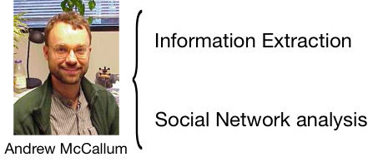
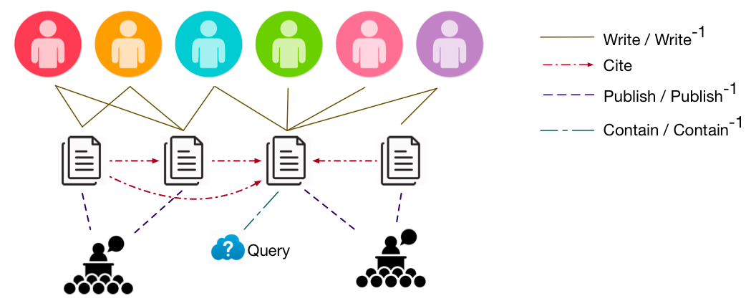
Ranking Experts in Heterogeneous Information Networks
Expert Finding: Based on both relevance and importance
Ranking in networks
Relevance Network
A candidate may have expertise on multiple topics
Only papers relevant to the query can serve as evidence
Heterogeneous Information Networks
Citation may have time-delay factor
Papers published in a higher-ranked venue are more likely to be important
Venues play an important role for ranking
Ranking Philosophy
Important & relevant papers will be cited by many important & relevant papers
Relevant experts will publish many important & relevant papers
Relevant conferences will publish many important & relevant papers

Slide 23
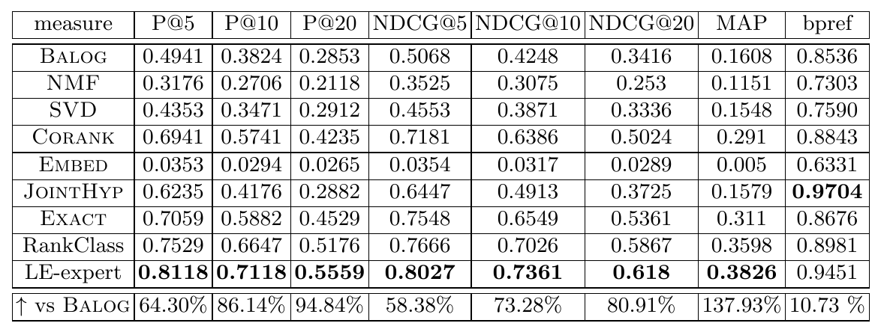
Experiments: LE-expert vs. Other Methods
Dataset (DBLP):
Documents: 2,244,018
Authors: 1,274,360
Labels (20 queries):
General: machine-learning, natural-language-processing, planning
Specific: face-recognition, information-extraction, kernel-methods, ontology-alignment…
boosting |  | support vector machine
Co-ranking | LE-expert | Co-ranking | LE-expert
Robert E. Schapire | Robert E. Schapire | Qi Wu | Bernhard Scholkopf
Yoav Freund | Yoav Freund | Isabelle Guyon | Vladimir Vapnik
Ron Kohavi | Leo Breiman | Jason Weston | Christopher J. C. Burges
Thomas G. Dietterich | Yoram Singer | Vladimir Vapnik | Thorsten Joachims
Yoram Singer | David P. Helmbold | Bao-Liang Lu | Chih-Jen Lin
information extraction |  | ontology alignment
Co-ranking | LE-expert | Co-ranking | LE-expert
Ralph Grishman | Dayne Freitag | Jerome euzenat | W. Marco Schorlemmer
Andrew McCallum | Ralph Grishman | Patrick Lambrix | Yannis Kalfoglou
Ellen Riloff | Andrew McCallum | Jason J. Jung | Anhai Doan
Oren Etzioni | Nicholas Kushmerick | He Tan | Jerome Euzenat
Dayne Freitag | Stephen Soderland | Marc Ehrig | Alon Y. Halevy
Significant improvement compared with document-based model (BALOG)
Case Study

Slide 24
Outline
Text Mining, Text Similarity and Text Embedding
Unsupervised word embedding
Context-free representation:
Euclidean Embedding: Word2Vec, GloVe, fastText
Local-Corpus Based Embedding
Hyperbolic Embedding: Poincaré and Lorentz Embedding
Spherical Text Embedding: JoSE (Joint Spherical Text Embedding)
Contextualized representation: ELMo, BERT, XLNet
CatE: Category-Name Guided Text Embedding for Topic Mining
Looking Forward

Slide 25
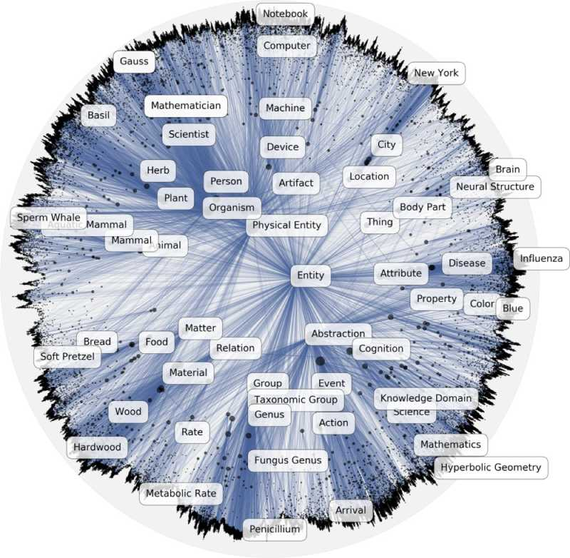
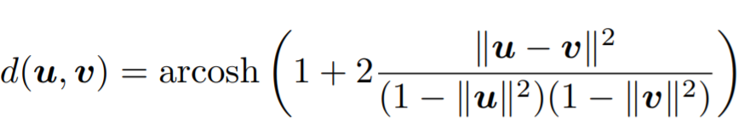
Hyperbolic Embedding: Poincaré embedding
Hyperbolic space = continuous version of trees
Naturally equipped to model hierarchical structures
Learns hierarchical representations by pushing general terms to the origin of the Poincaré ball, and specific terms to the boundary
Nickel, M., & Kiela, D. (2017). Poincaré Embeddings for Learning Hierarchical Representations. NIPS.

Slide 26
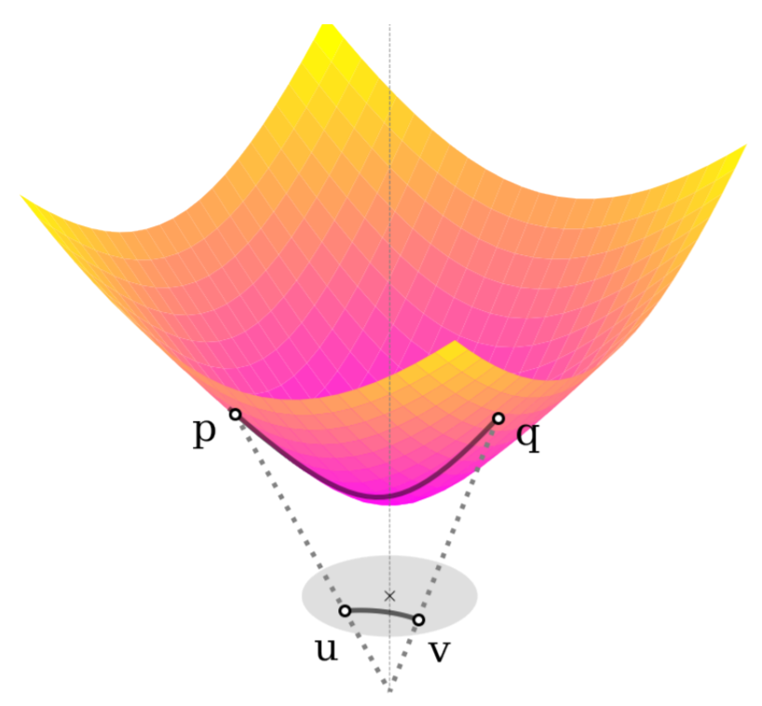
Hyperbolic Embedding: Lorentz Embedding
Extend the previous Poincaré embedding
Comparison between Poincaré vs. Lorentz:
The Poincaré disk is intuitive for visualizing and interpreting hyperbolic embeddings
The Lorentz model is well-suited for Riemannian optimization
Strategy:
Learn embedding via Lorentz model
Project embedding into the Poincaré disk
Nickel, M., & Kiela, D. (2018). Learning Continuous Hierarchies in the Lorentz Model of Hyperbolic Geometry. ICML.

Slide 27
Outline
Text Mining, Text Similarity and Text Embedding
Unsupervised word embedding
Context-free representation:
Euclidean Embedding: Word2Vec, GloVe, fastText
Local-Corpus Based Embedding
Hyperbolic Embedding: Poincaré and Lorentz Embedding
Spherical Text Embedding: JoSE (Joint Spherical Text Embedding)
Contextualized representation: ELMo, BERT, XLNet
CatE: Category-Name Guided Text Embedding for Topic Mining
Looking Forward

Slide 28
Spherical Text Embedding
Spherical Text Embedding:
“Spherical”: Embeddings are trained on the unit sphere, where vector norms are ignored and directional similarity is directly optimized
“Text Embedding”: Instead of training word embeddings only, we jointly train paragraph (document) embeddings with word embeddings to capture the local and global contexts in text embedding
Yu Meng, Jiaxin Huang, Guangyuan Wang, Chao Zhang, Honglei Zhuang, Lance Kaplan and Jiawei Han, “Spherical Text Embedding”, NeurIPS, Dec. 2019
A spherical generative model that jointly exploits word-word (local) and word-paragraph (global) co-occurrence statistics
An efficient optimization algorithm in the spherical space with convergence guarantee
State-of-the-art performance on various text embedding applications

Slide 29
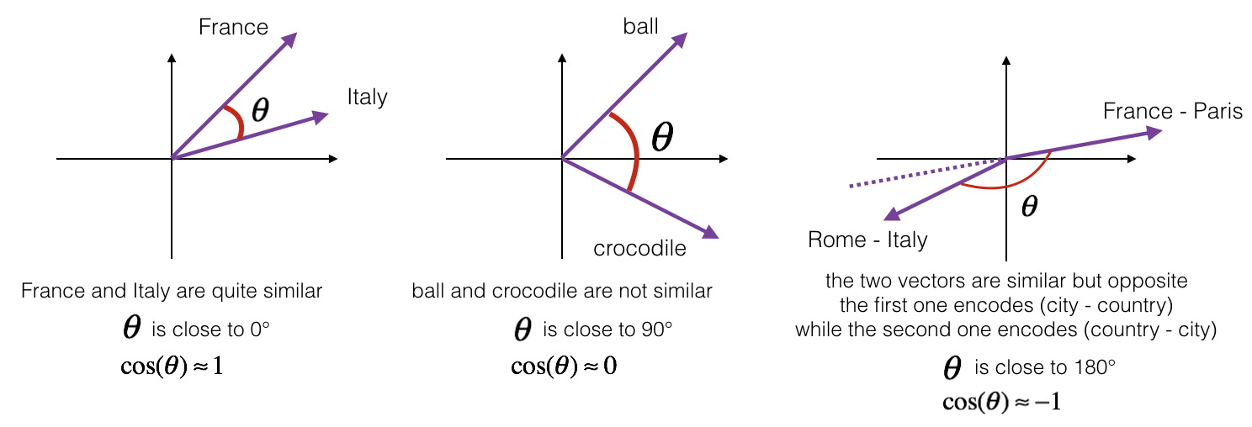
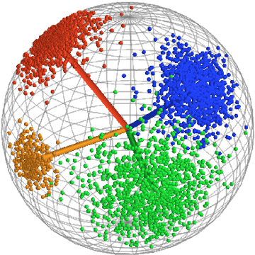
Why Spherical Text Embedding?
Previous text embeddings (e.g., Word2Vec) are trained in the Euclidean space
But used on spherical space—Mostly directional similarity (i.e., cosine similarity)
Word similarity is derived using cosine similarity
Word clustering (e.g., TaxoGen) is performed on a sphere
Better document clustering performances when embeddings are normalized and spherical clustering algorithms are used

Slide 30
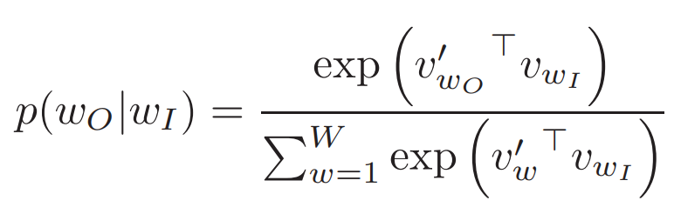
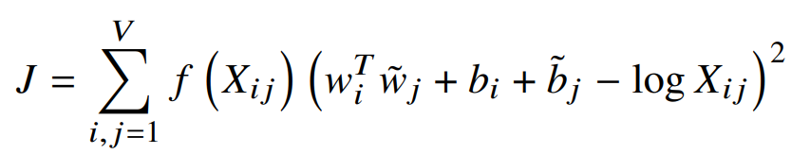
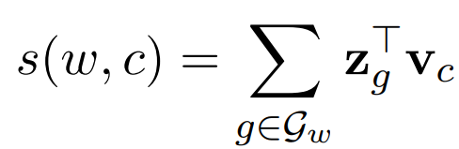
Inconsistency Between Training and Usage Space
The inconsistency between word embedding training and usage space
The objective we optimize during training is not really the one we use
Regardless of the different training objective, Word2Vec, GloVe and fastText all optimize the embedding dot product during training, but cosine similarity is what actually used in applications
Embedding dot product is optimized during training
Word2Vec
GloVe
fastText

Slide 31
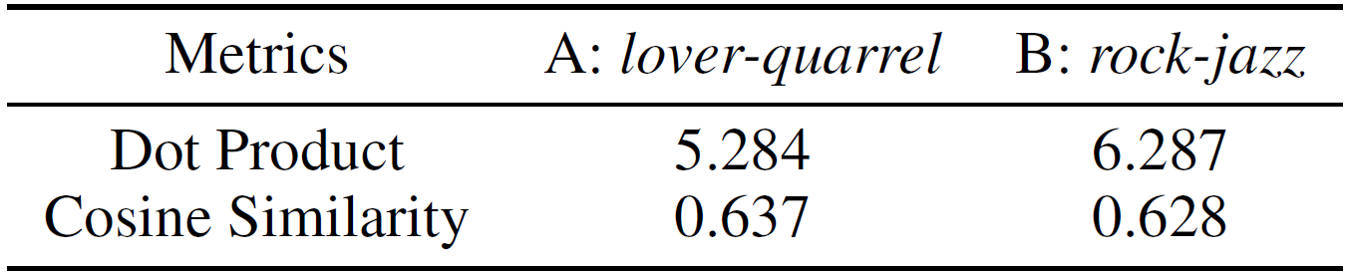

Consequence of Such Inconsistency
Consequence: The objective we optimize during training is not really the one we use
Ex: Consider two pairs of words, A: lover-quarrel; B: rock-jazz
Pair B has higher ground truth similarity than pair A in WordSim353 (a benchmark test set)
Word2Vec assigns higher dot product to pair B, but its cosine similarity is still smaller than pair A
Training
Usage
Inconsistency

Slide 32
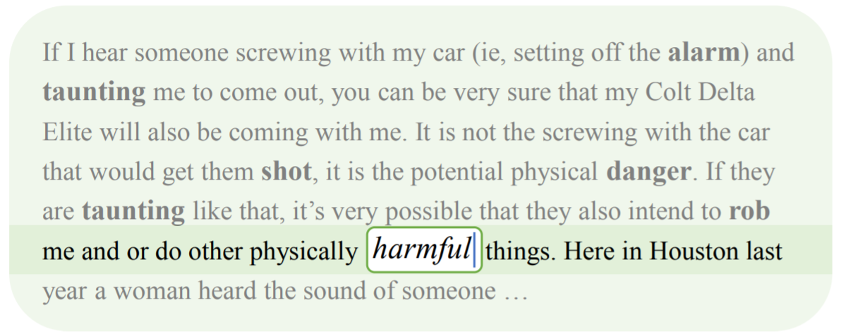
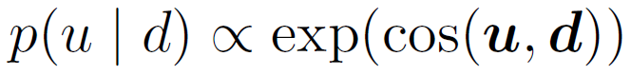
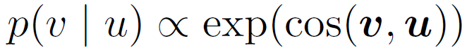
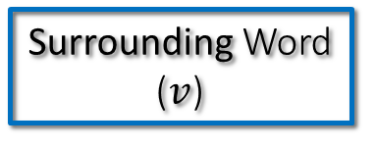
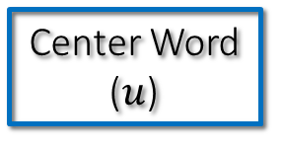
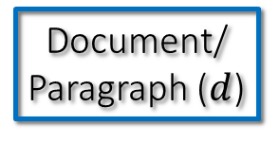
Another Observation: Integrating Local and Global Contexts
Local contexts can only partly define word semantics in unsupervised word embedding learning
Design a generative model on the sphere that follows how humans write articles:
First a general idea of the paragraph/doc, then start to write down each word in consistent with not only the paragraph/doc, but also the surrounding words
Local contexts of “harmful”
Document/
Paragraph ($d$)
Center Word ($u$)
Surrounding Word ($v$)

Slide 33
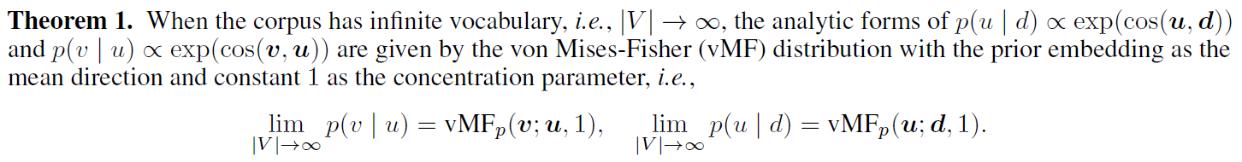
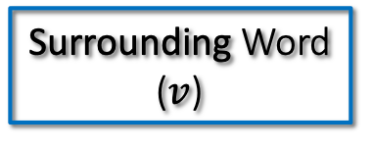
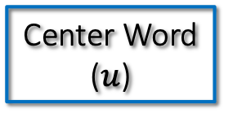
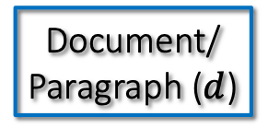
Model: Spherical Text Embedding
How to define the generative model in the spherical space?
Document/
Paragraph ($d$)
Center Word ($u$)
Surrounding Word ($v$)
What are their expressions on the sphere?
A theorem connecting the above generative model with a spherical probability distribution

Slide 34
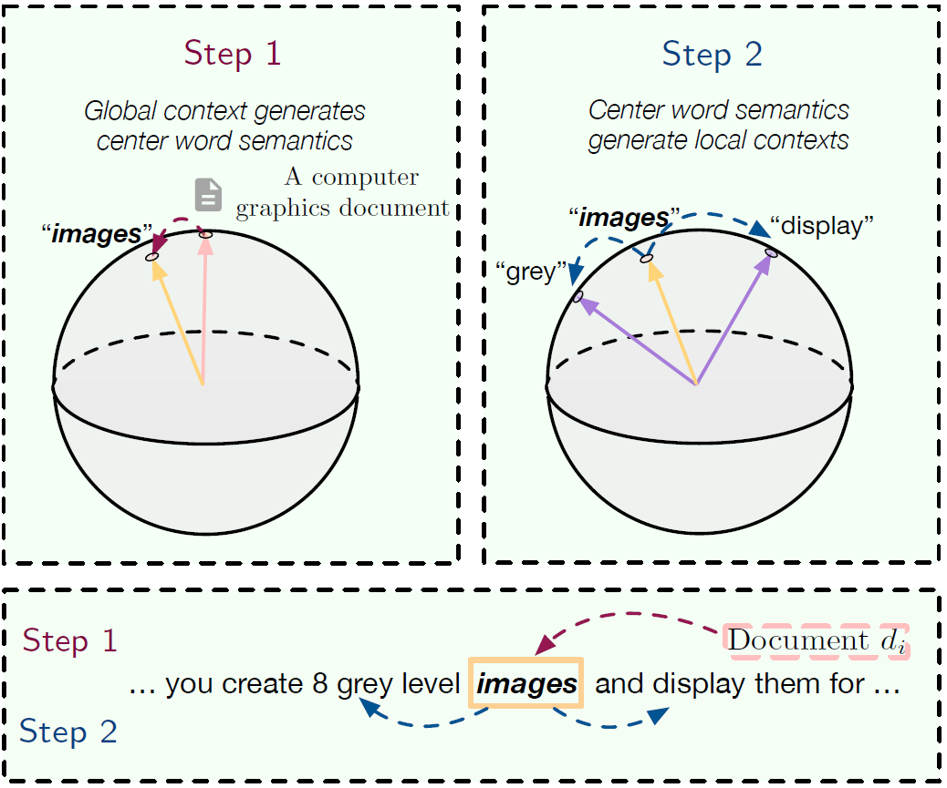
Understanding the Spherical Generative Model

Slide 35
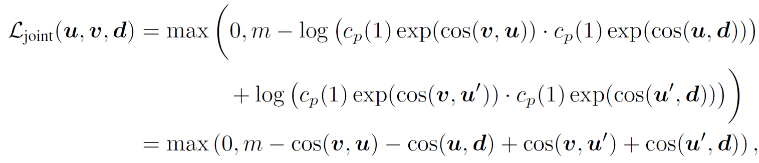
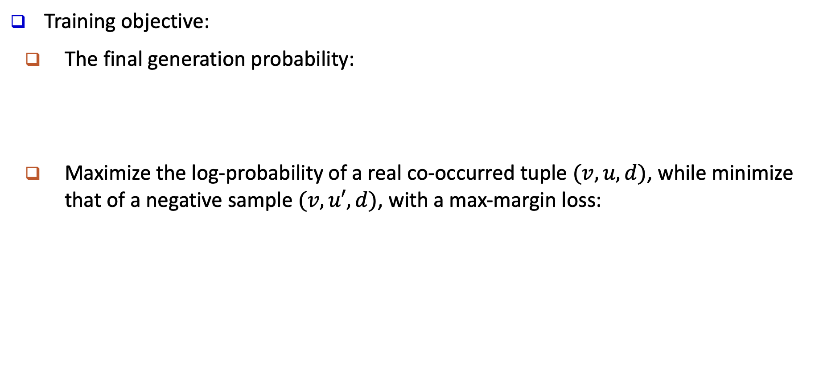
Modeling Spherical Text Embedding
Training objective:
The final generation probability:
Maximize the log-probability of a real co-occurred tuple $(v, u, d)$, while minimize that of a negative sample $(v, u′, d)$, with a max-margin loss:
Positive Sample
Negative Sample

Slide 36
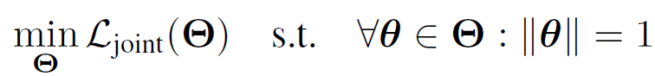
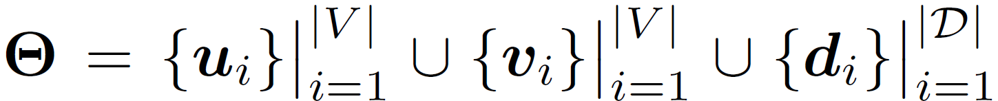
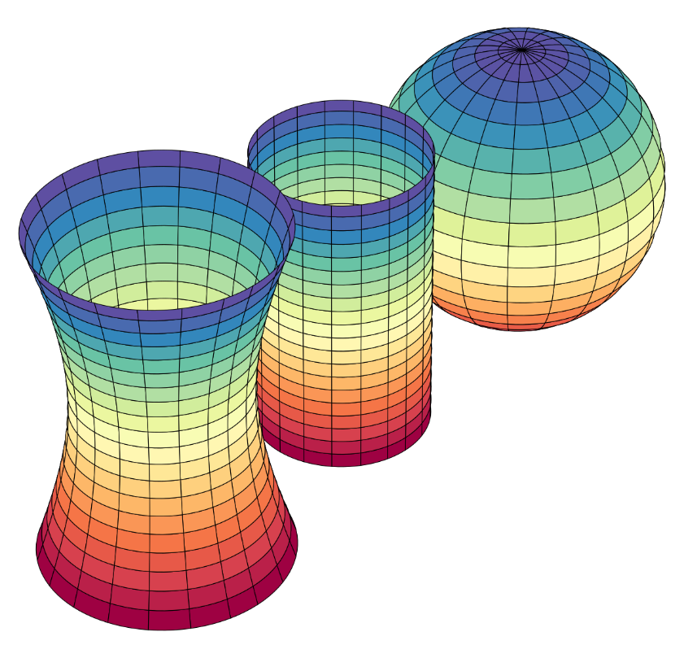
Computation: Optimization on the Sphere
The constrained optimization problem:
Challenge: Parameters must be always updated on the sphere, but Euclidean optimization methods (e.g., SGD) are not constrained on a curvature space
Need to consider the nature of the spherical space
Riemannian manifold:
The sphere is a Riemannian manifold with constant positive curvature
Sphere
Cylinder/Plane
Hyperboloid

Slide 37





Riemannian Optimization with Riemannian SGD
Riemannian gradient:
Exponential mapping (maps from the tangent plane to the sphere):
Riemannian SGD:
Retraction (first-order approximation of the exponential mapping):

Slide 38
Word Similarity: Experiment Setting
Data and Measures
Train 100-d word embedding on the latest Wikipedia dump (~13G)
Compute embedding cosine similarity between word pairs to obtain a ranking of similarity
Benchmark datasets contain human rated similarity scores
The more similar the two rankings are, the better embedding reflects human thoughts
Spearman’s rank correlation is used to measure the ranking similarity
Baselines
Euclidian Space: Word2Vec, GloVe, fastText, BERT (NAACL, 2019)
Poincare Space: Poincaré glove: Hyperbolic word embeddings (ICLR, 2019)
Spherical Space: JoSE (our full model)

Slide 39

Word Similarity: Performance Comparison
Why does BERT fall behind on this task?
BERT learns contextualized representations, but word similarity is conducted in a context-free manner
BERT is optimized on specific downstream tasks like predicting masked words and sentence relationships, which have no direct relation to word similarity

Slide 40
Document Clustering: Experiment Setting
Data and Measures
Train document embedding on 20News dataset (20 classes)
Perform K-means and Spherical K-means (SK-means)
Metrics: Mutual Information (MI), Normalized Mutual Information (NMI), Adjusted Rand Index (ARI), and Purity
Run clustering 10 times and report the above metrics with mean and standard deviation
Baselines:
Euclidian Space: Avg. Word2Vec, BERT
SIF: Simple but tough-to-beat baseline for sentence embeddings. In ICLR, 2017
Doc2Vec: Distributed representations of sentences and documents. In ICML, 2014
Spherical Space: JoSE (our full model)

Slide 41

Document Clustering: Performance Comparison
Embedding quality is generally more important than clustering algorithms
Using spherical K-Means only gives marginal performance boost over K-Means
JoSE embedding remains optimal regardless of clustering algorithms

Slide 42

Document Classification: Experiment Results
Train doc embedding on 20News (20 classes) and Movie review (2 classes) dataset
Perform k-NN classification (k=3): similar comparison results with k from [1, 10]
k-NN is non-parametric and directly reflect how well the topology of the embedding space captures document-level semantics
Metrics: Macro-F1 & Micro-F1
Baselines: Same with document clustering

Slide 43



Training Efficiency & Case Studies
Training efficiency
Acronym → similar words
Other models’ objectives contain many non-linear operations, whereas JoSE only has linear terms in the objective
Testing antonym similarity

Slide 44
Outline
Text Mining, Text Similarity and Text Embedding
Unsupervised word embedding
Context-free representation:
Euclidean Embedding: Word2Vec, GloVe, fastText
Local-Corpus Based Embedding
Hyperbolic Embedding: Poincaré and Lorentz Embedding
Spherical Text Embedding: JoSE (Joint Spherical Text Embedding)
Contextualized representation: ELMo, BERT, XLNet
CatE: Category-Name Guided Text Embedding for Topic Mining
Looking Forward

Slide 45
From Context-Free Embedding to Contextual Embedding
Previous unsupervised word embeddings like Word2Vec and GloVe learn context-free word embedding
Each word has one representation regardless of specific contexts it appears in
E.g., “bank” is a polysemy, but only has one representation
Recent popular deep language models overcome this problem by learning contextual relations between words and sentences
“Open a bank account”
“On the river bank”
Share representation

Slide 46

ELMo: Deep Contextualized Word Representations
Word representations are learned functions of the internal states of a deep bi-directional LSTMs
Results in a pre-trained network that benefits several downstream tasks (e.g. Sentiment analysis, Named entity extraction, Question answering)
However, left-to-right and right-to-left LSTMs are independently trained and concatenated
Peters, M.E., Neumann, M., Iyyer, M., Gardner, M.P., Clark, C., Lee, K., & Zettlemoyer, L.S. (2018). Deep contextualized word representations. NAACL.

Slide 47

BERT: Deep Bidirectional Transformers
Bidirectional: BERT leverages a Masked LM learning to introduce real bidirectionality training
Masked LM: With 15% words randomly masked, the model learns bidirectional contextual information to predict the masked words
Devlin, Jacob, et al. "Bert: Pre-training of deep bidirectional transformers for language understanding." NAACL (2019).

Slide 48
BERT: Deep Bidirectional Transformers
Transformer Encoder: Reads the entire sequence of words at once; learns the context of a word based on all of its surroundings
The Transformer employs an attention mechanism that learns contextual relations between words (and sub-words) in a text sequence

Slide 49
BERT: Deep Bidirectional Transformers
Next Sentence Prediction: BERT receives pairs of sentences as input and learns to predict if the second sentence in the pair is the subsequent sentence in the original document

Slide 50

XLNet: Autoregressive Language Modeling
Instead of using Masked LM, XLNet uses Permutation Language Modeling
Permutes the text sequence and predicts the target word using the remaining words in the sequence
Since words in the original sequence are permuted, both forward direction information and backward direction information are leveraged
Yang, Z., Dai, Z., Yang, Y., Carbonell, J., Salakhutdinov, R., & Le, Q. V. (2019). XLNet: Generalized Autoregressive Pretraining for Language Understanding. NeurIPS’19

Slide 51

XLNet: Two-Stream Self-Attention
Content representation: Encodes both token position as well as content
Query representation: Encodes only token position
Content representation
Query representation

Slide 52
Outline
Text Mining, Text Similarity and Text Embedding
Unsupervised word embedding
Context-free representation:
Euclidean Embedding: Word2Vec, GloVe, fastText
Local-Corpus Based Embedding
Hyperbolic Embedding: Poincaré and Lorentz Embedding
Spherical Text Embedding: JoSE (Joint Spherical Text Embedding)
Contextualized representation: ELMo, BERT, XLNet
CatE: Category-Name Guided Text Embedding for Topic Mining
Looking Forward

Slide 53
From Unsupervised Embedding to Weakly-Supervised Embedding
Unsupervised word embedding can be used as word representations/features in a wide spectrum of text mining tasks
However, unsupervised word embeddings are generic word representations
Not yielding the best performance on downstream tasks (e.g., taxonomy construction, document classification)
Reason: Not incorporating task-specific information
We introduce a weakly-supervised embedding learning method called CatE that learns category distinctive embeddings
Yu Meng, Jiaxin Huang, Guangyuan Wang, Zihan Wang, Chao Zhang, Yu Zhang and Jiawei Han, ”Discriminative Topic Mining via Category-Name Guided Text Embedding”, in Proc. 2020 Int. World Wide Web Conf. (WWW’20), Taipei, Taiwan, Apr. 2020

Slide 54
Introduction: Idea of CatE
CatE consists of two key modules:
A weakly-supervised word embedding learning module that regularizes the embedding space based on category representative words
A selection module that selects category representative words based on both word embedding similarity and word distributional specificity
The two modules collaborate in an iterative way: At each iteration,
The former refines embeddings for accurate representative words selection
The latter selects representative words that will be used by the former in the next iteration

Slide 55

Introduction: Why Category Name Guided Embedding?
CatE does not require any hand-labeled data, but only leverages category names to learn word embeddings with discriminative power over the specific set of categories
Inputs: Category names + Corpus
E.g., the same set of celebrities should be embedded differently given different sets of category names

Slide 56
Topic Modeling and Its Challenges
Topic models [LDA: Blei, Ng, Jordan 2003; pLSA: Hofmann 1999]
Unsupervised statistic tools that discover latent topics from text corpora
Optimized under a generative process: Maximal likelihood of the observed data
Tend to discover the most dominant or superficial topics: may not be of user’s particular interest, or provide a skewed and biased summarization of the corpus
Not explicitly enforce the retrieved topics to be distinctive from each other
Example:
Later developments
Supervised LDA and DiscLDA: But rely on massive hand-labeled documents
Seed-guided topic modeling: Still not impose requirements on the distinctiveness of the retrieved topics

Slide 57
Discriminative Topic Mining: General Philosophy
Discriminative Topic Mining [Meng et al., WWW 2020]
Takes a set of category names as user guidance
Retrieve a set of representative and discriminative terms in each category
Method: CatE: category-name guided text embedding for discriminative topic mining
A category-name guided text embedding learning module (E):
Takes a set of category names to learn category distinctive word embeddings by modeling the text generative process conditioned on the user provided categories
A category representative words retrieval module (R):
Selects category representative words based on both word embedding similarity and word distributional specificity
The two modules (E + R) collaborate in an iterative way:
E refines word embeddings and category embeddings
R selects representative words that will be used by E in the next iteration

Slide 58
Discriminative Topic Mining: Problem Formulation
Definition: Given a text corpus D and a set of category names C = {c₁, . . . , c_{n} }
Discriminative topic mining aims to retrieve a set of terms S_{i} = {w₁, . . . , w_{m}} from D for each category c_{i} such that each term in S_{i} semantically belongs to and only belongs to category c_{i}
Example: Given c₁: “The United States”, c₂: “France” and c₃: “Canada”
Correct: “Ontario” in S₃ (a province in Canada; but not in other categories)
Incorrect: “North America” in S₃ (not belong to any countries)
Incorrect: “English” in S₃ (English is also the national language of the United States)
Key points:
Requires a set of user-provided category names and only focuses on retrieving terms belonging to this specific set of categories
Imposes strong discriminative requirements: Each retrieved term must belong to and only belong to that category semantically

Slide 59
Related Work: Task-Oriented Text Embedding
Supervised word embedding: Explicitly leverage category info. to optimize embedding; but require labeled training documents to fine-tune word embeddings
Predictive Text Embedding (PTE) [Tang et al,. KDD 2015]: constructs a heterogeneous text network and jointly embeds words, documents and labels based on word-word and word-document co-occurrences plus labeled documents
Label-Embedding Attentive Model [Wang et al. ACL 2018]: jointly embeds words and labels so that attention mechanisms can be employed to discover category distinctive words
Learning embedding for lexical entailment: Help determine which terms belong to a category
Hyperbolic models (Poincaré, Lorentz, and hyperbolic cone)
Proven successful in graded lexical entailment detection
supervised and require hypernym-hyponym training pairs
CatE jointly learns the word vector representation in the embedding space and its distributional specificity without requiring supervision, and simultaneously consider relatedness and specificity of words when retrieving category representative terms

Slide 60
Why New Approaches for Discriminative Topic Mining?
Traditional topic models (e.g., LDA)
Use document-topic and topic-word distributions to model text generation process
The bag-of-words generation assumption: Each word is drawn independently from the topic-word distribution w.o. considering correlations between adjacent words
Make explicit probabilistic assumptions regarding the text generation mechanism, resulting in high model complexity and inflexibility
Traditional word embedding approach (e.g., Word2Vec)
Effectively capture word semantic correlations by mapping words with similar local contexts closer in the embedding space
Not impose particular assumptions on the type of data distribution of the corpus and enjoy greater flexibility and higher efficiency
But word embeddings usually do not exploit document-level co-occurrences of words (i.e., global contexts) and also cannot naturally incorporate latent topics into the model without making topic-relevant generative assumptions

Slide 61
Modeling Text Generation: A Three-Step Process
Step 1: Document d is generated conditioned on one of the n categories
Explicitly models the associations between each document and user-interested categories (i.e., topic assignment)
Step 2: Each word w_{i} is generated conditioned on the semantics of the document d
Makes sure each word is generated in consistency with the semantics of its belonging document (i.e., global contexts
Step 3: Surrounding words w_{i+j} in the local context window (−h ≤ j ≤ h) of w_{i} are generated conditioned on the semantics of the center word w_{i}
Models the correlations of adjacent words in the corpus (i.e., local contexts)
Thus the likelihood of corpus generation conditioned on a specific set of user-interested categories C: (where c_{d} is the latent category of d)

Slide 62
Derivation: Finding Words that Belong to Categories
Take negative log-likelihood as our objective L:
In Eq. (2), p(w_{i}|d) and p(w_{i+j}|w_{i}) are observable while p(d | c_{d} ) is latent
To directly leverage the word level user supervisions (i.e., category names), a natural solution is to decompose p(d|c_{d}) into word-topic distributions:
Rewrite the first term in Eq. (2) by reorganizing the summation over categories instead of documents:
This becomes the category assignment of words, i.e., finding words that belong to the categories

Slide 63
Formulate It as an Embedding Learning Problem
Formulate the optimization of the objective L as an embedding learning problem
Define the 3 probability expressions in Eq. (2) via log-linear models in the embedding space
Eqs. (4) and (5) can be directly plugged into Eq. (2) to train word and document embeddings
Eq. (3) requires knowledge about the latent topic (i.e., the category that w belongs to) of a word w. Initially, we only know the user-provided category names, but with iterative topic mining, we will retrieve more terms under each category, gradually discovering the latent topic of more words
u_{w}: input vector representation of w (usually used as the word embedding)
v_{w}: output vector representation that serves as w’s contextual representation
d: the document embedding
c_{i}: the category embedding

Slide 64
Retrieval of Category Representative Terms
Retrieve category representative terms by jointly considering two separate aspects: Relatedness and specificity
Constraint 1: w is semantically related to c
Simply requiring high cosine similarity between a candidate word embedding and the category embedding
Constraint 2: w is semantically more specific than the category name of c
Improving the text embedding model by incorporating word specificity signals
Word Distributional Specificity: Assume there is a scalar κ_{w} ≥ 0 correlated with each word w indicating how specific the word meaning is
The bigger κ_{w} is, the more specific meaning w has, and the less varying contexts w appears in
Example: seafood vs. food

Slide 65
Jointly Learning Word Embedding and Distributional Specificity
Modify Eqs. (4) and (5) to incorporate an additional learnable scalar κ_{w} for each word w, while constraining the embeddings to be on the unit hyper-sphere S^{p−1}
The unit norm constraints can be satisfied by simply normalizing the embedding vectors after each update. The κ_{w} learned is the distributional specificity of w.
The contexts vectors are assumed to be generated from the vMF distribution with the center word vector u_{wi} as the mean direction and κ_{wi} as the concentration parameter
Our model essentially learns both word embedding and word distributional specificity that maximize the probability of the context vectors getting generated by the center word’s vMF distribution

Slide 66
Ranking Measure for Category Representative Words Retrieval
A category representative word must have higher distributional specificity than the category name
We also want to avoid selecting too specific terms as category representative words, which may appear fewer times in the corpus and suffer from lower embedding quality and higher variance due to insufficient training
Among all the words that are more specific than the category name, we prefer words that (1) have high embedding cosine similarity with the category name, and (2) have low distributional specificity, which indicates wider semantic coverage
where rank_{sim}(w, c_{i}) is the ranking of w by embedding cosine similarity with category c_{i}, i.e., cos(u_{w}, c_{i}), from high to low; rank_{spec}(w) is the ranking of w by distributional specificity, i.e., κ_{w}, from low to high

Slide 67
Experiment Setting: Datasets and Preprocessing
Two datasets:
New York Times annotated corpus (NYT)
Two categories: topic and location
Recently released Yelp Dataset Challenge (Yelp)
Two categories: food type and sentiment
Preprocessing:
Use AutoPhrase to extract quality phrases, treated as single words during embedding training
Hyperparameter setting:
word embedding dimension p = 100
local context window size h = 5
number of negative samples k = 5
training iterations on the corpus max_iter = 10
Dataset stat: # of docs by category name

Slide 68
Compared Baselines and Evaluation Metrics
Baselines: including traditional topic modeling, seed-guided topic modeling and embedding-based topic modeling
Input: # of topics N. We vary N in [n, 2n, . . . , 10n] where n is the actual number of categories and report the best performance of the method.
Compared methods: LDA [NIPS’08], Seeded LDA [EACL’12], TWE [AAAI’15], Anchored CorEx [TACL’17], Labeled ETM [Dieng, Ruiz, Blei’19]
Evaluation Metrics
Topic coherence (TC): Term coherence inside each topic (avg. normalized PMI of two words randomly drawn from the same document)
Mean accuracy (MACC): The proportion of retrieved top words that actually belong to the category defined by user-provided category names
P(w_{i} ,w_{j}): probability of w_{i} and w_{j} co-occurring in a document
1(wi ∈ ck ): indicator function of whether w_{i} belongs to category c_{k}

Slide 69
Performance Study on Discriminative Topic Mining
Quantitative comparison
Qualitative comparison
@the next page
Discussion
LDA retrieves reasonably good topics relevant to category names but need careful manual selection of topics
Four guided topic modeling baselines alleviate the burden of manual selection
Seeded LDA and Anchored CorEx may get semantically irrelevant results
TWE and Labeled ETM employ distributed word representations, obtaining semantically relevant terms but may not actually belong to the corresponding category (e.g., “Germany” and “Europe” under “Britain”)

Slide 70
Comparative Evaluation of Discriminative Topic Mining

Slide 71
Experiments on Weakly-Supervised Document Classification
Weakly-supervised document classification: uses category names or a set of keywords from each category instead of human annotated documents to train a classifier
We use WeSTClass [CIKM’18] as the weakly-supervised classification model, but replace Word2Vec with different embedding models as input features
Compared Methods
Word2Vec: a predictive word embedding model that learns distributed representations by maximizing the probability of using the center word to predict its local context words or in the opposite way.
GloVe: learns word embedding by factorizing a global word-word co-occurrence matrix where the co-occurrence is defined upon a fix-sized context window
fastText [TACL’17]: extension of by incorporating subword information
BERT [NAACL’19]: A state-of-the-art pretrained language model (using bidirectional Transformers) that provides contextualized word representations

Slide 72
Results on Weakly-Supervised Document Classification
Weakly-supervised document classification evaluation based on WeSTClass model
Unsupervised embeddings (Word2Vec, GloVe and fastText) do not really have notable differences as word representations to WeSTClass
BERT is not suitable for classification without sufficient training data, probably because BERT embedding has higher dimensionality, which might require stronger supervision signals to tune
CatE outperforms all unsupervised embeddings but only marginally for NYT-topic
Weakly-supervised classification: Under label scarcity scenarios, using word-level supervision only can bring significant improvements to weakly-supervised models

Slide 73
Unsupervised Lexical Entailment Direction Identification
Lexical entailment (LE) refers to the “type-of” (aka. hyponymy-hypernymy) relation
Discriminate hypernymy from other relations (detection)
Identify which one is hyponymy (direction identification)
Compared Methods: focus on unsupervised methods for LE direction identification
Frequency: “hypernyms are more frequent than hyponyms in the corpus”
SLQS [EACL’14]: measures the generality of a term via the entropy of its statistically most prominent context
Vec-Norm: A general term tends to have a lower embedding norm (it co-occurs with many different terms and its vector is dragged from different directions)
HyperVec [EMNLP’17]: arranging the word embedding training order corresponding to the hypernym–hyponym distributional hierarchy
Accuracy for hypernymy direction identification: “training” on the latest Wikipedia dump (w. 2.4 billion tokens)

Slide 74

Case Study I: Visualize the Trained Embeddings
Visualize the embeddings trained on NYT-Location
star (category embeddings), points (phrases)
The categories become well-separated in the embedding space during training
Category representative words gather around their corresponding category in the embedding space
Other semantically similar words move towards their belonging categories as well

Slide 75

Case Study 2: Effect of Distributional Specificity
Coarse-to-fine topic presentation on NYT-Topic
The table below lists the most similar words/phrases with each category (measured by embedding cosine similarity) from different ranges of distributional specificity
When $κ$ is smaller, the retrieved words have wider semantic coverage
In our model design, if not imposing constraints on the distributional, the retrieved words might be too general and do not belong to the category

Slide 76

Application: Support Multi-Dimensional Text Analysis
Ukraine-Russia Conflicts: MH17 Shot-Down
Notes:
Use caseolap to capture top-10 representative phrases for the cell of 2014-07, Cherkasy and the topic of infrastructure.
Keyphrase results: …
We also extract sentences that cover most of the keywords as summarization for the cell.
News images are collected from documents belonging to this cell, and they depict the scene of the plane crash.

Slide 77

Analysis of Russia-Ukraine Conflicts
category names and three examples from the experts
Category representative phrases generated automatically
Notes:
Category representative phrases are generated automatically using the embedding training algorithm CatE introduced in section 2. Briefly, we train the embedding for each topic using three keywords from experts as weak supervision. For example, we have … as keywords for topic political, then we can regularize the semantic space and found words under the topic of political, such as ….

Slide 78

Multidimensional Analysis of News Data : HK Protests
Top-k phrases generated by CatE
Summary: extracted w. top-k phrases

Slide 79

Analysis of Hong Kong Protests
Category representative phrases generated automatically
category names and three examples from the experts

Slide 80
Outline
Text Mining, Text Similarity and Text Embedding
Unsupervised word embedding
Context-free representation:
Euclidean Embedding: Word2Vec, GloVe, fastText
Local-Corpus Based Embedding
Hyperbolic Embedding: Poincaré and Lorentz Embedding
Spherical Text Embedding: JoSE (Joint Spherical Text Embedding)
Contextualized representation: ELMo, BERT, XLNet
CatE: Category-Name Guided Text Embedding for Topic Mining
Looking Forward

Slide 81
Looking Forward: Structural Mining of Massive Text Data
From big data to big knowledge
A key problem: Structural mining of massive text data
Lots to be explored!!!
Heterog. networks
Text Corpus
Phrases
Knowledge
General KB
Typed entities
Multi-dimensional Cubes

Slide 82
Summary
Big data and big network challenge: The curse of high dimensionality
Embedding: A powerful new approach
Mapping high dimensional data into low-dimensional vector space
Tons of research work on embedding (we focus on text analysis)
Word embedding from massive text data: Word2Vec (Mikolov et al. NIPS’2013)
Spherical text embedding (Meng et al. NeurIPS’19)
Broad applications
Word/phrase similarity analysis, document clustering, classification, …
Discriminative topic mining
Future work
A lot of exciting work to come

Slide 83

References (I)
A. Banerjee, I. S. Dhillon, J. Ghosh, and S. Sra. Clustering on the unit hypersphere using von mises-fisher distributions. Journal of Machine Learning Research, 6:1345–1382, 2005
K. Batmanghelich, A. Saeedi, K. Narasimhan, and S. J. Gershman. Nonparametric spherical topic modeling with word embeddings. In ACL, 2016
P. Bojanowski, E. Grave, A. Joulin, and T. Mikolov. Enriching word vectors with subword information. TACL, 2017
S. Bonnabel. Stochastic gradient descent on Riemannian manifolds. IEEE Transactions on Automatic Control, 58:2217–2229, 2013
K. Cho, B. van Merrienboer, Çaglar Gülçehre, D. Bahdanau, F. Bougares, H. Schwenk, and Y. Bengio. Learning phrase representations using rnn encoder-decoder for statistical machine translation. In EMNLP, 2014
J. Devlin, M.-W. Chang, K. Lee, and K. Toutanova. Bert: Pre-training of deep bidirectional transformers for language understanding. NAACL (2019)
B. Dhingra, C. J. Shallue, M. Norouzi, A. M. Dai, and G. E. Dahl. Embedding text in hyperbolic spaces. In TextGraphs@NAACL-HLT, 2018
Adji B. Dieng, Francisco J. R. Ruiz, and David M. Blei. 2019. Topic Modeling in Embedding Spaces. ArXiv abs/1907.04907 (2019)
O.-E. Ganea, G. Bécigneul, and T. Hofmann. Hyperbolic entailment cones for learning hierarchical embeddings. In ICML, 2018

Slide 84
References (II)
H. Gui, Q. Zhu, L. Liu, A. Zhang, J. Han. Expert Finding in Heterogeneous Bibliographic Networks with Locally-trained Embeddings. ArXiv: 1803.03370 (2018)
Y. Kim. Convolutional neural networks for sentence classification. In EMNLP, 2014
S. Kumar and Y. Tsvetkov. Von mises-fisher loss for training sequence to sequence models with continuous outputs. In ICLR, 2019
Q. V. Le and T. Mikolov. Distributed representations of sentences and documents. In ICML, 2014
Yang Liu, Zhiyuan Liu, Tat-Seng Chua, and Maosong Sun. 2015. Topical Word Embeddings. In AAAI.
Y. Meng, J. Huang, G. Wang, C. Zhang, H. Zhuang, L. Kaplan and J. Han, "Spherical Text Embedding", NeurIPS’19
Y. Meng, J. Shen, C. Zhang, and J. Han. Weakly-supervised neural text classification. In CIKM, 2018
Y. Meng, J. Shen, C. Zhang, and J. Han. Weakly-supervised hierarchical text classification. In AAAI, 2019
Y Meng, J. Huang, G. Wang, Z. Wang, C. Zhang, Y. Zhang and J. Han, "Discriminative Topic Mining via Category-Name Guided Text Embedding", WWW’20
T. Mikolov, K. Chen, G. S. Corrado, and J. Dean. Efficient estimation of word representations in vector space. CoRR, abs/1301.3781, 2013

Slide 85
References (III)
T. Mikolov, I. Sutskever, K. Chen, G. S. Corrado, and J. Dean. Distributed representations of words and phrases and their compositionality, NIPS’13
M. Nickel and D. Kiela. Poincaré embeddings for learning hierarchical representations. In NIPS, 2017
M. Nickel and D. Kiela. Learning continuous hierarchies in the Lorentz model of hyperbolic geometry. In ICML, 2018
J. Pennington, R. Socher, and C. D. Manning. GloVe: Global vectors for word representation. In EMNLP, 2014
Peters, M.E., Neumann, M., Iyyer, M., Gardner, M.P., Clark, C., Lee, K., & Zettlemoyer, L.S. (2018). Deep contextualized word representations. NAACL.
J. Tang, M. Qu, and Q. Mei. PTE: Predictive text embedding through large-scale heterogeneous text networks. In KDD, 2015
J. Tang, M. Qu, M. Wang, M. Zhang, J. Yan, and Q. Mei, “LINE: Large-scale information network embedding”, WWW’15
F. Tao, C. Zhang, X. Chen, M. Jiang, T. Hanratty, L. M. Kaplan, and J. Han. Doc2cube: Allocating documents to text cube without labeled data. In ICDM, 2018
Yang, Z., Dai, Z., Yang, Y., Carbonell, J., Salakhutdinov, R., & Le, Q. V. (2019). XLNet: Generalized Autoregressive Pretraining for Language Understanding. NeurIPS’19

